Slide 1
e-Business Definition and Dimensions
Definition
Dimensions

Slide 2
Definition
E-business is application of digital technology particularly internet technologies to improve organization’s competitiveness through continuous optimization (Chaffey, 2015; Turban et al., 2012, Strauss and Frost, 2014). It differs from e-commerce, m-commerce and e-marketing.

Slide 3
Definition
E-Commerce: The subset of e-business focused on transactions that included buying/selling online, digital value creation, virtual marketplaces and storefronts, and new distribution channel intermediaries.

Slide 4
Definition
M-Commerce: The subset of e-commerce focused on electronic transactions and communications conducted using mobile devices such as smartphones and tablets, and typically with a wireless connection

Slide 5
Definition
E-Marketing: The subset of e-commerce that focused on achieving marketing objectives through using electronic communications technology

Slide 6
Dimensions
E-business dimensions consist of content, experience and platform (Weill and Woerner, 2013); e-information, e-communication and e-workflow (Merono-Cerdan and Soto-Acosta, 2005); e-commerce, e-procurement, e-cooperation, e-service, e-process and e-network (Lee and Han, 2009)

Slide 7
Dimensions
Content (what is consumed?): Product information, price and use details, etc.; Digital products, such as e-books, e-saver accounts, movies, software.
Experience (how is it packaged?). Experience can include customer-facing digitized business processes, community and customer input, expertise for informed decision making, recommendations, tools and interface.
Platform (how is it delivered?). Other business processes, customer data, technology; Proprietary hardware, public networks, partners.

Slide 8
E-information
It provides corporate or commercial information to customers, business partners or other stakeholders (shareholders, employees, the public, etc.).
Corporate information provides insight into the background of the company (financial statements, employment offers, quality certificates, etc.) and commercial information implies providing product-related information, such as prices, specifications, terms of delivery, etc.

Slide 9
E-communication
It offers a unique and integrated opportunity for interacting with several business agents (both internal and external to the organization).
It facilitates the exchange of information, collaboration and the possibility of establishing close relationships based on trust and mutual commitment. The exchange of information can vary from more structured tools, such as the feedback form, to more open and interactive forms, such as the online chat feature.
https://slack.com/intl/es-mx/blog/collaboration/electronic-communication-in-business

Slide 10
E-workflow
A workflow is ‘the automation of a business process, in whole or in part, during which documents, information or tasks are passed from one participant to another for action, according to a set of procedural rules e-business provides great opportunity for automation of processes’. It involves the establishment of predefined electronic processes.
https://www.integradoc.com/que-es-un-workflow/#:~:text=Un%20workflow%2C%20o%20flujo%20de,un%20objetivo%20de%20la%20organizaci%C3%B3n.

Slide 11
E-procurement
The business-to-business or business-to-consumer purchase and sale of supplies and services through the Internet as well as other information and networking systems, such as Electronic Data Interchange and Enterprise Resource Planning
Who is most important, customer or provider?
https://www.ionos.mx/digitalguide/online-marketing/vender-en-internet/ebusiness/#:~:text=Econom%C3%ADa%20de%20red%20y%20eBusiness&text=Este%20t%C3%A9rmino%20hace%20referencia%20al,transacci%C3%B3n%20en%20las%20diferentes%20plataformas.

Slide 12
E-cooperation
It is based on three levels of abstraction: cooperative framework, cooperative process, and cooperative step.
A cooperative process is a process meant to orchestrate the execution of a specific aspect of the cooperation between a numbers of business partners. The elements of a process are mainly represented by cooperative steps required to specific of roles).
A cooperative set is an atomic unit of activity inside a cooperative processes. It can involve a single role, or it can require the coordination of two or more of roles.
https://ivypanda.com/essays/e-collaboration-strategic-and-competitive-opportunities/

Slide 13
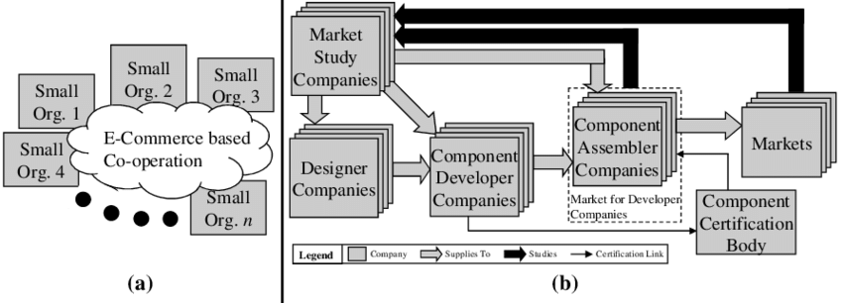
E-cooperation

Slide 14
E-service
It defines as internet-based applications and services which are offered as individual products to solve a specific business need that seamlessly integrates with the customer’s processes.
https://www.mbaknol.com/information-systems-management/an-introduction-to-e-services/

Slide 15
E-Commerce models
  Business to consumer (B2C)
  Business to business (B2B)
  Customers to business (C2B)
  Customers to Customers (C2C)
  Direct to costumer (D2C)
  Online to Offile – Offline to Online (O2O)

Slide 16
References:
Chaffey, D., 2015, Digital Business and E-Commerce Management: Strategy, Implementation and Practice, Sixth Edition, Pearson Education Limited, United Kingdom.
Lee, M-C., Han, M-W., 2009, E-Business Model Design and Implementation in Supply-Chain Integration, WISA ’09, May 22-24, pp. 001-004, Nanchang, P.R. China
Merono-Cerdan, A.L., Soto-Acosta, P., 2005, Examining E-Business Impact on Firm Performance through Website Analysis, Int. J. Electronic Business, Vol. 3, No. 6
Strauss, J., Frost, R., 2014, E-Marketing, Seventh Edition, Pearson Education, Inc., New Jersey
Turban, E. et al., 2012, Electronic Commerce 2012: A Managerial and Social Networks Perspective, Seventh Edition, Pearson Education, London
Weill, P., Woerner, S.L., 2013, Optimizing Your Digital Business Model, MITSloan Management Review, Spring 2013, Vol. 54 No. 3

